Slide 1
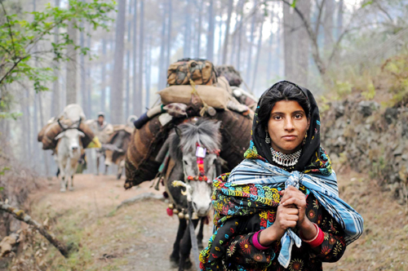
Seasonal Livestock Movement and Nomadic Migration in J&K
Present Scenario and Way Ahead
Dr Arshdeep Singh, IFS
Conservator of Forests,
J&K Forest Department
Mudasir Mehmood,SFS
Deputy Conservator of Forests,
J&K Forest Department

Slide 2
Introduction
Pastoralists can be defined as "members of caste or ethnic groups with a strong traditional association with livestock-keeping, where a substantial proportion of the group derive over 50% of household consumption from livestock products or their sale, and where over 90% of animal consumption is from natural pasture or browse, and where households are responsible for the full cycle of livestock breeding."
(Ref.: Sharma et al)

Slide 3
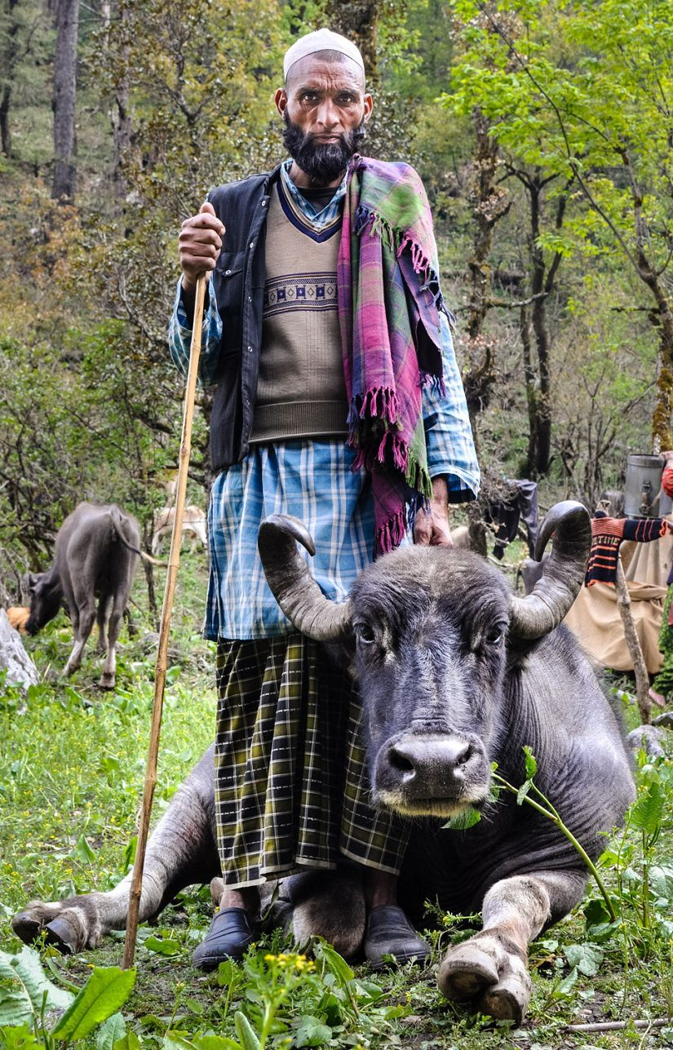
Pastoralism in Himalayas
Pastoralism in the Himalayas is based on transhumant practices and involves cyclical movements from lowlands to highlands to take advantage of seasonally available pastures at different elevation in the Himalayas.
Migratory pastoralism is common throughout the Himalayas. All of these herders continue a long-standing tradition of migrating up to the alpine pastures of the high Himalayas for the summer and descending to the low-lying Himalayan foothills in the winter.
Some pastoralists in the Himalayas are agro-pastoralists and besides rearing animals they also cultivate land, although the major portion of their household income is drawn from pastoral activities.

Slide 4
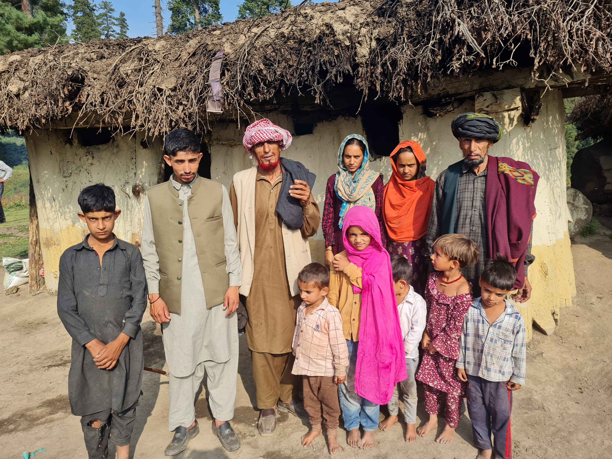
PASTORALIST TRIBES OF JAMMU AND KASHMIR
Name of Tribe | Districts | Population | Primary Activities
Bakerwals | Rajouri, Poonch, Udhampur, Kathua, Jammu and Doda | 1331198 | Pastoralist community, predominantly Goat and Sheep herders
Balti | Gurez, Ladakh, Kargil | 51918 | Settled community
Gaddi | Bhaderwah, Basohli, Ram Nagar, Batote, Udhampur, Bilawar and Ramban | 46489 | Shepherds of Jammu region
Gujjars | Srinagar, Doda, Kupwara, Kishtwar, Ramban, Poonch, Rajouri etc. | 980654 | Semi-nomadic Pastoral community
Chopans | All districts of Kashmir and Chenab Valleys | NA | Summer-Pastoralists, who rent-graze sheep of local communities

Slide 5
Types of Migrations in Himalayas
Based on Migration Types:
Nomadic Herders:
They do not cultivate land and their entire livelihood revolves around pastoral activities. They mostly depend on their neighboring agricultural communities for cultivable goods for which they perform extensive economic exchange with them.
Semi-Nomadic Pastoralists:
These nomadic groups own cultivable land and during half of the year are involved in agricultural activities.
Long-distance or Transhumant Herders:
Livestock is generally accompanied by hired men but also by owners and their relatives, but rarely by a whole family, on a long migration or transit between two seasonal ranges"
Based on Location:
Intra-District Migartion- Poonch to Mandi
Inter District Migration- Jammu to Rasi
Inter-Province Migartion- Major migration, e.g, Reasi to Sonamarg
Inter State migartion- e.g. Kathua to Himachal

Slide 6
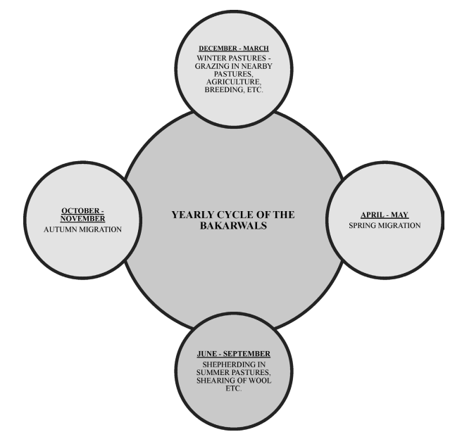
Typical Migration Cycle of Bakarwals

Slide 7
Behak Partal-An Important Exercise
Grazier information of Kashmir, South Circle
Behak Partal is important exercise taken by Forest Department to collect data on Graziers.
Forest Department also provides moment passes to the migratory graziers.
Both the above are an important Baseline Data and also a legal instrument for resource ownerships.
Data deficiency is considered one of the main issues related to framing of policies for their socio-economic development. By strengthening such instruments good baseline data can be generated.
Behak Partal exercise needs to be refined and integrated with other departments to meet the modern enabling policy requirements.
Behak Partal data can also serve as an important record for availing benefits under Forest Rights Act or other such enabling acts.

Slide 8
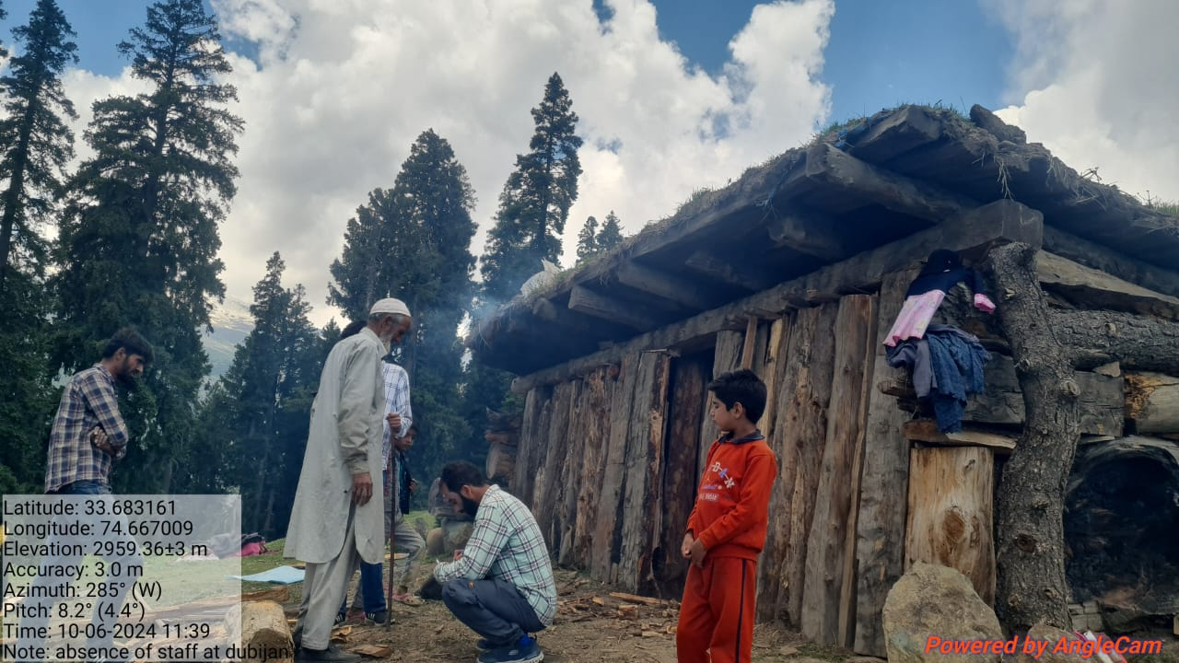
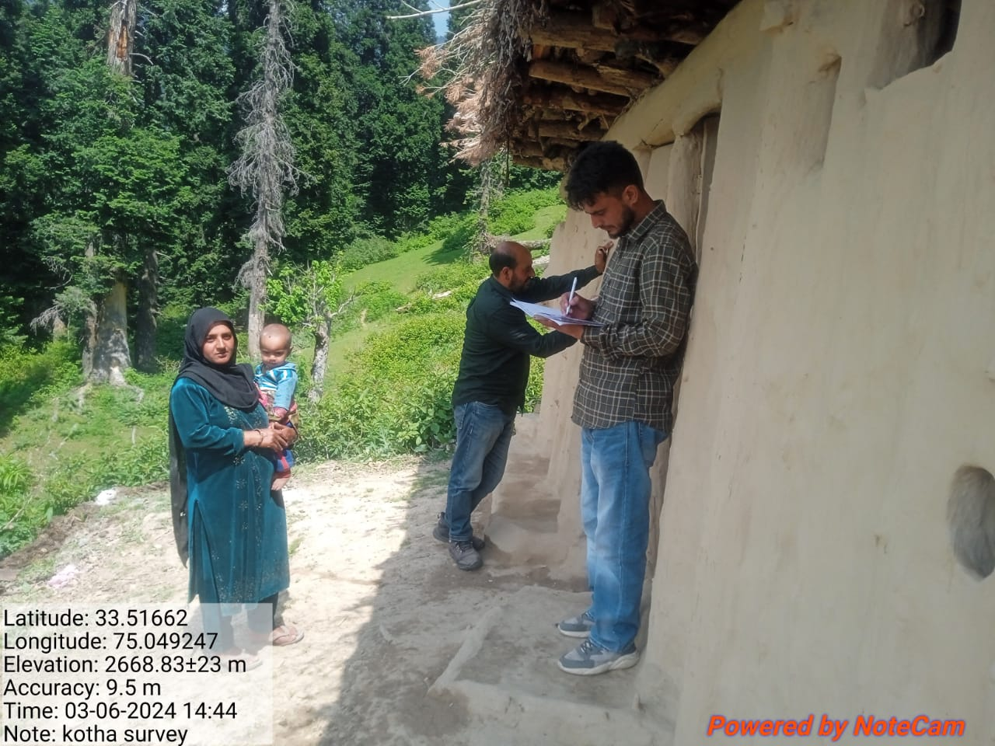
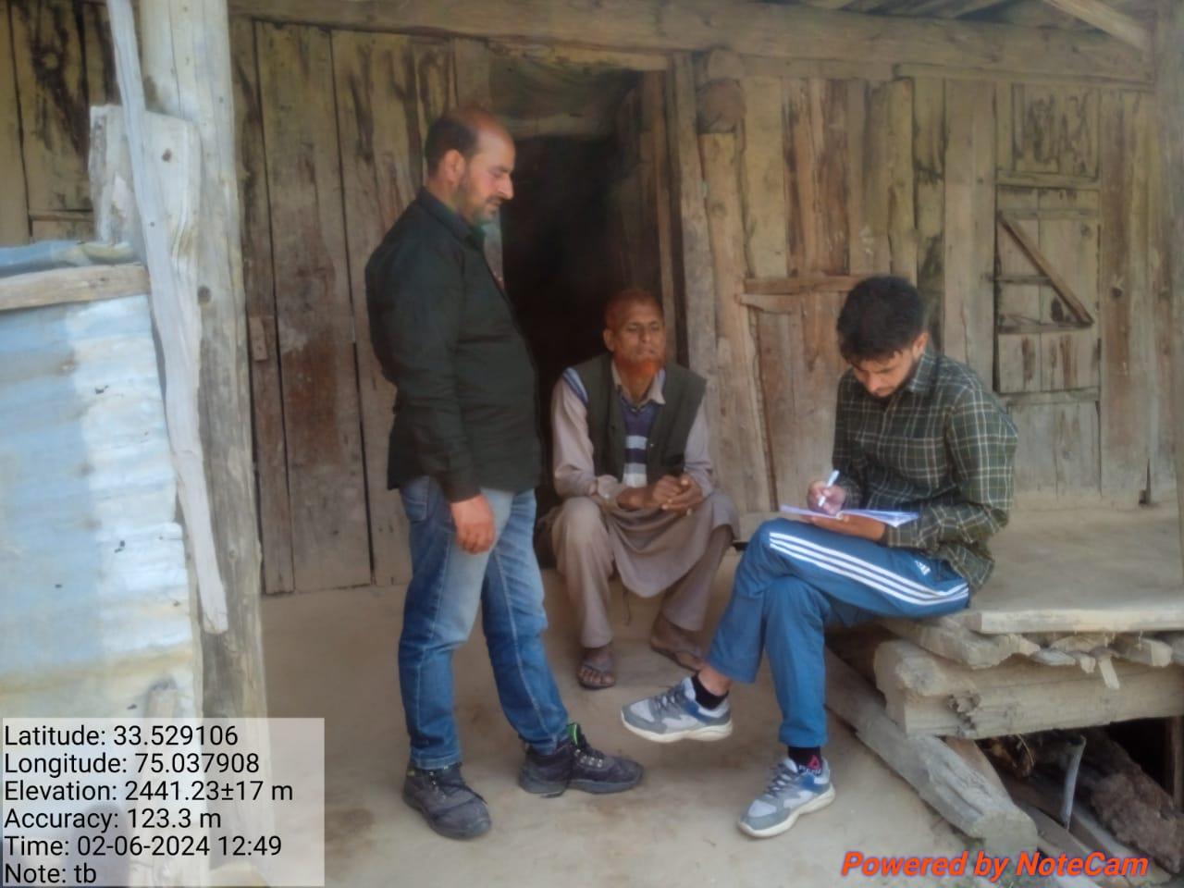
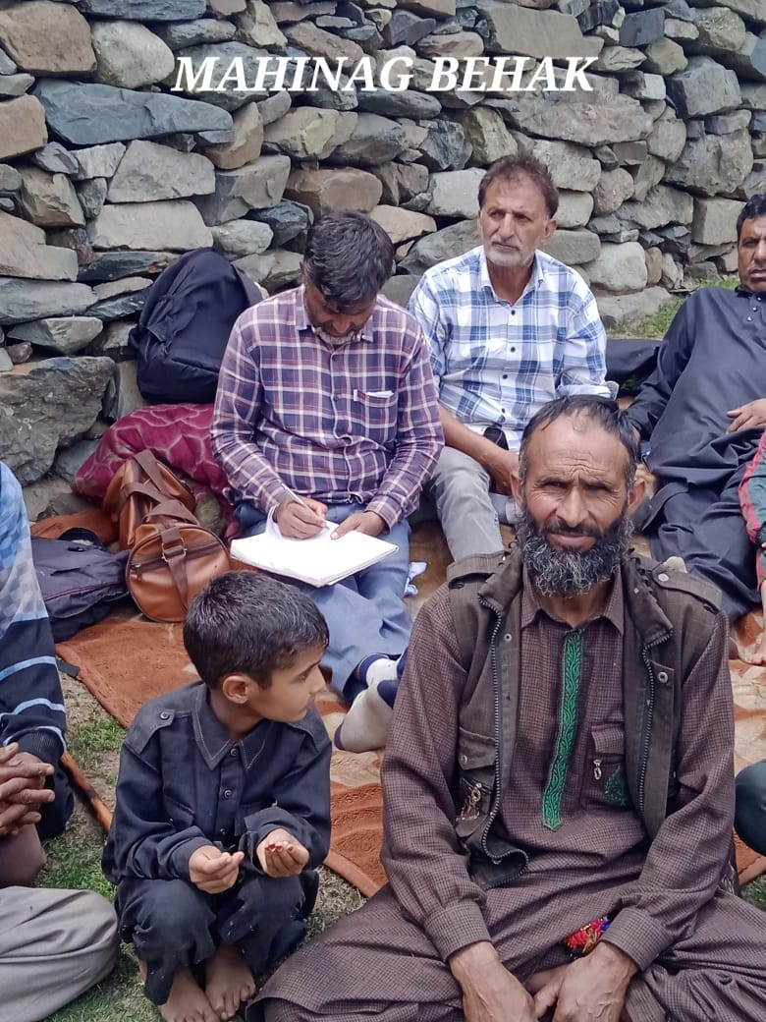
SNIPPETS FROM
SOUTH KASHMIR FORESTS
FOREST EMPLOYEES CARRYING
BEHAK PARTAL (JUNE 2024)

Slide 9
Outcome of Behak Partal
Grazier information of Kashmir, South Circle
Forest D | No. of Grazier families | No. of Behaks | No. of Animals | No. of Animals per Grazier family
Anantnag/Lidder | 716 | 172 | 18897 | 29
Pulwama | 179 | 36 | 6792 | 38
Shopian | 2221 | 116 | 34620 | 27
Kulgam | 879 | 123 | 36111 | 41
Total | 5769 | 447 | 158220 | 27

Slide 10
Routes of The Tribal Communities of Jammu and Kashmir viz-a-viz South Kashmir
District | Migration routes and mountain passes | Destination
Ramban | Banihal pass | Nowgam (shahabad Anantnag)
 | Pogal Paristan | Kapran (Shahabad Anantnag)
 | Banihal Pass-Warwan | Marwah
 | Banihal Pass | Verinag
Reasi | Banihal Pass | Verinag
 | Jhajji Pass | Pahalgam, Kokernag
 | Patnitop | Sinthantop
 | Banihal pass | Nowgam (shahabad Anantnag)
 | 1. Banihal Pass-Kokernag (Anantnag)-Matigavaran-Lathalwan-Wadhwan 2.Gool-Arnas-Ramban-Kokernag (Anantnag)-Margan Top | Santhal (Ramban), Wadhwan, Lawali
Poonch | Gali Chamaran-Parh-Tarkana-Gali Tarahn Aali | Masloon Aali (Poonch), Oochi
 | Khilo-Gali-Toti-Roopalo-Galiyan_x0002_Taara Aali- Seeinaali-Gagarh | Pathrein (Mandi)

Slide 11
Contd...
District | Migration routes and mountain passes | Destination
 | Mandi-Sawjiyan-Satarban-Jamiyan Gali | Kapral (Jamiyan), Purjidhar (Gulmarg)
 | Sawjiyan- Jamiyan Gali | Purjidhar (Gulmarg)
 | Mandi-Sarimangyana-Diwar Gali | Purjidhar (Gulmarg)
Jammu | 1.Patnitop-Banihal Pass-Ladho-Chadgaso 2. Patnitop-Dachhan-Kibernala | Ashmagam, Marwah, Batkote,Dhupatti
 | Ladhadhar-Banihal Pass-Durru-Islamabad-Salur-Mukam | Pahalgam
 | Ladhadhar-Banihal | Pahalgam
 | Mansar-Banihal-Durru-Bal-Mattan-Seer_Makaam-Matkoot | Dudhal-Chanwarhi (Pahalgam)
 | Sanasar-Banihal-Margan Top-Inshan | Wadwan
Sambha | 1. Sanasar-Banihal Pass-Kokernag_Daksum 2. Udhampur-Patnitop-Verinag 3. Sanasar-Banihal Pass -Margan Top_Minjhal (Inshan) | Daksum (Kokernag, Anantnag), Wadhwan
Kathua | Bani-Basohli- Sarthal-Jaayi-Thathri_Kishtwar | Dachhan (Wadhwan)

Slide 12
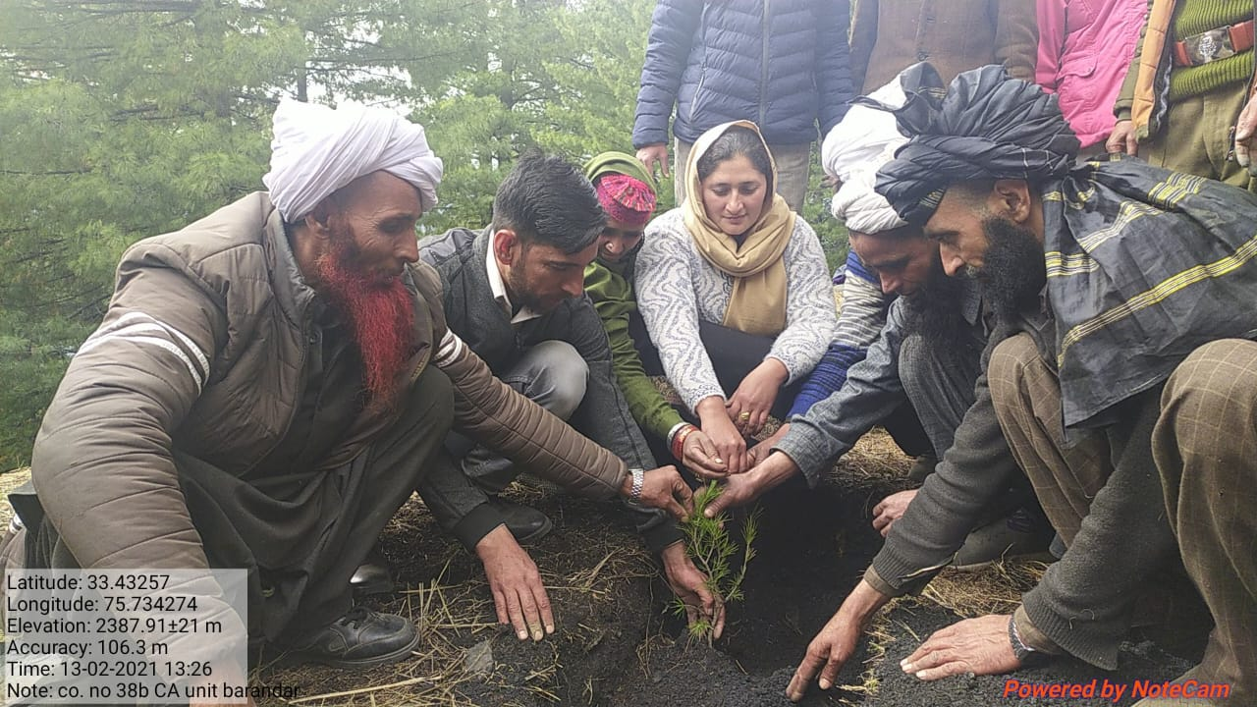
Forests and the Tribals
Forest Ecosystem & Tribals share an intricate bond- The Ecosystem People.
They have deep understanding of the forests- Traditional Botanical Knowledge and the Dynamics of Forest Ecosystems.
All their activities are done within or adjoining to forest landscapes.
A healthy forest ecosystem means better lives for the pastoralists.
They are solely dependent on forests for the Fodder, Fuelwood ,Water and other usufructs.
The Behaks or the Dhoks ( local name for pastures) their migratory homes are located in the forests.
The Behak Dispute resolutions are moderated by Forest Department.

Slide 13
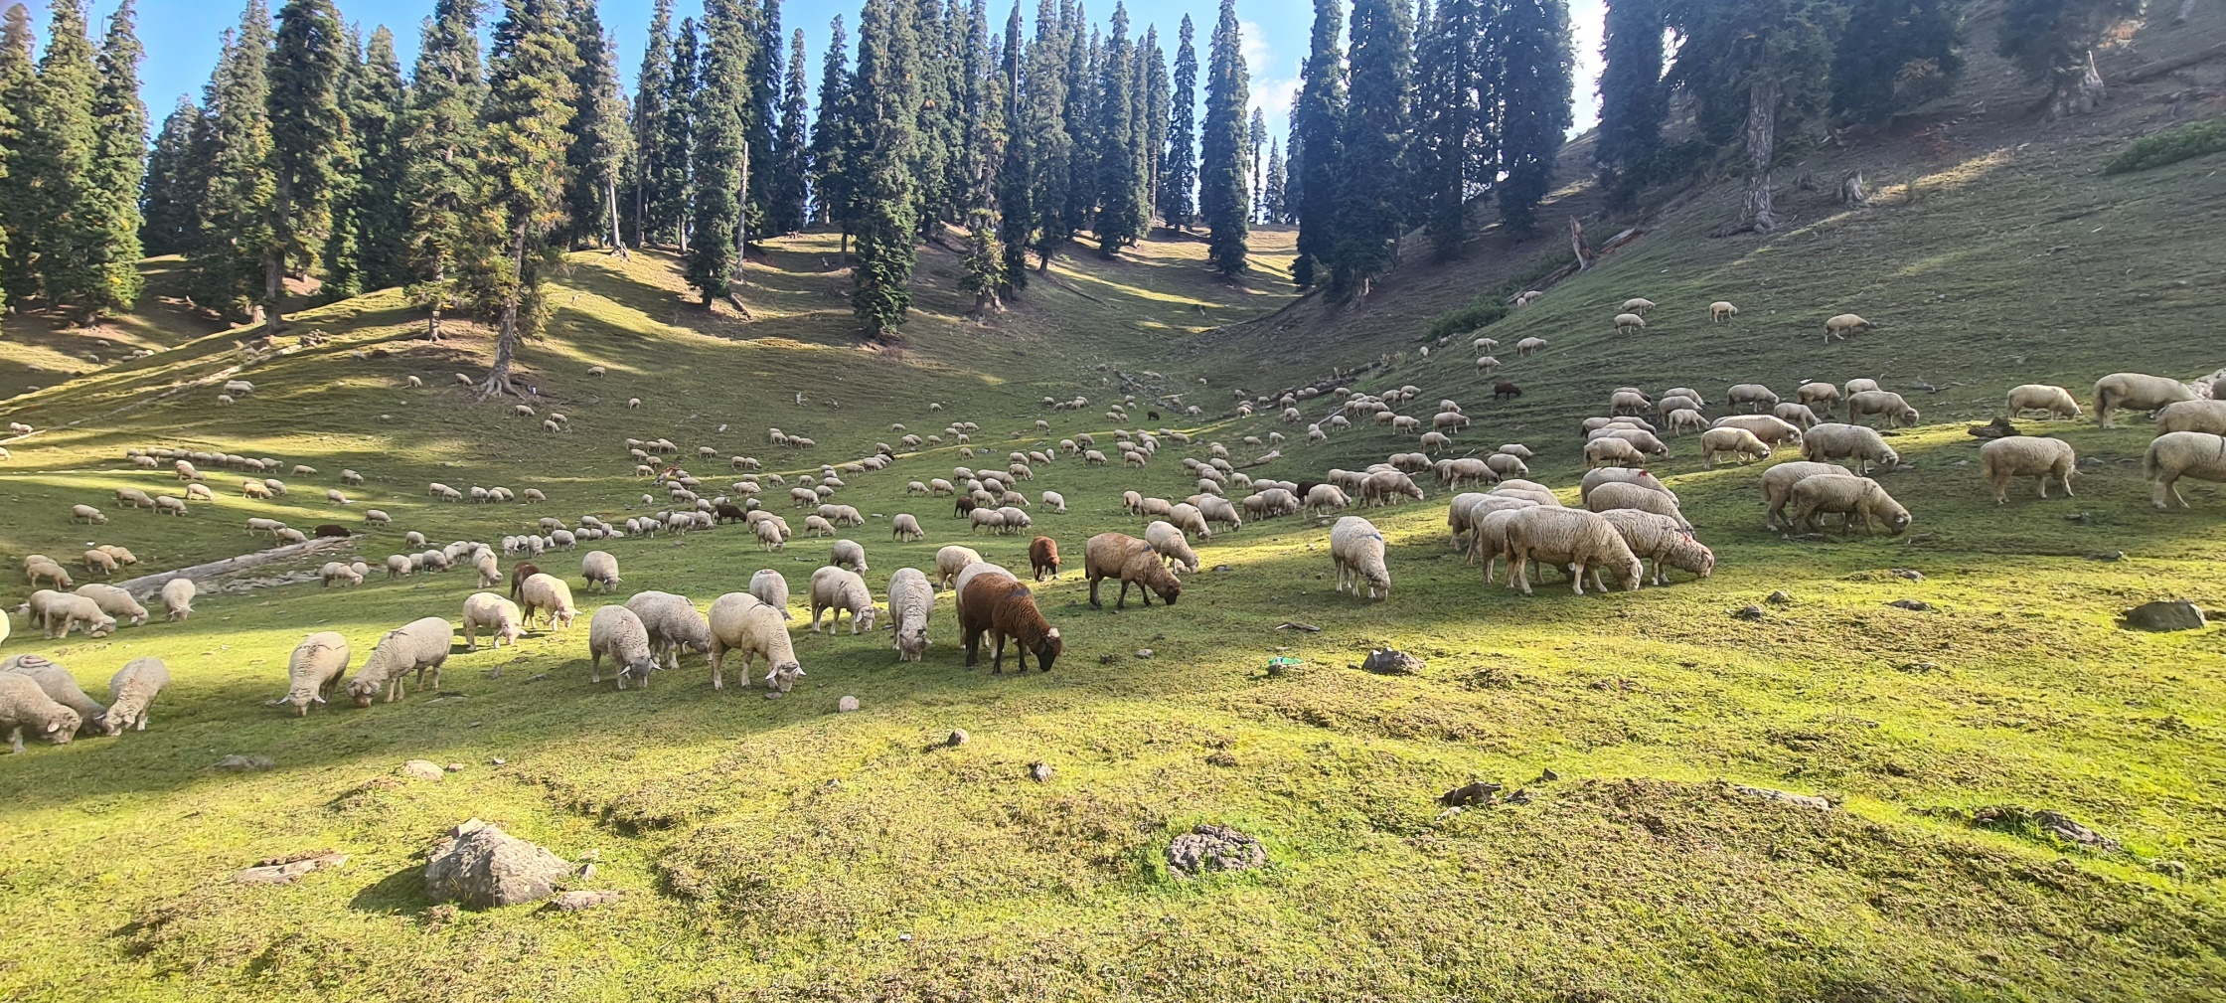
Some Tangibles from JK Forests
Source: ISFR, 2019
Fuelwood (Tonnes) | Fodder (Tonnes) | Bamboo (Tonnes) | Small Timber (Cum)
1298816 | 14017803 | 94 | 19763

Slide 14
Issues faced by Grazing communities
Traditional Issues:
Village as unit of Development- Pastoralists are a nation on move
Non Recognition of Pastoral Land rights The customary usage of the forest resources or common lands is not officially recognized, thus Himalayan pastoralists are simply not understood as the stakeholders in their own land resources. This is very evident during the time of their displacement as a result of government projects such as Hydel power, social welfare programmes or National Parks where the pastoralist are completely ignored in the times of rehabilitation.
Population growth & Land fragmentation
Livelihood Threats
Reduced Pastures due to afforestation activities (enclosures)/Road construction & developmental projects/security establishments/agricultural expansions.
Disturbed Migratory Patterns-Tourism infrastructure/Power Projects/Road construction etc
Lack of linkage to outside world & access to information
Dilemma between education & Pastoral Livelihoods

Slide 15
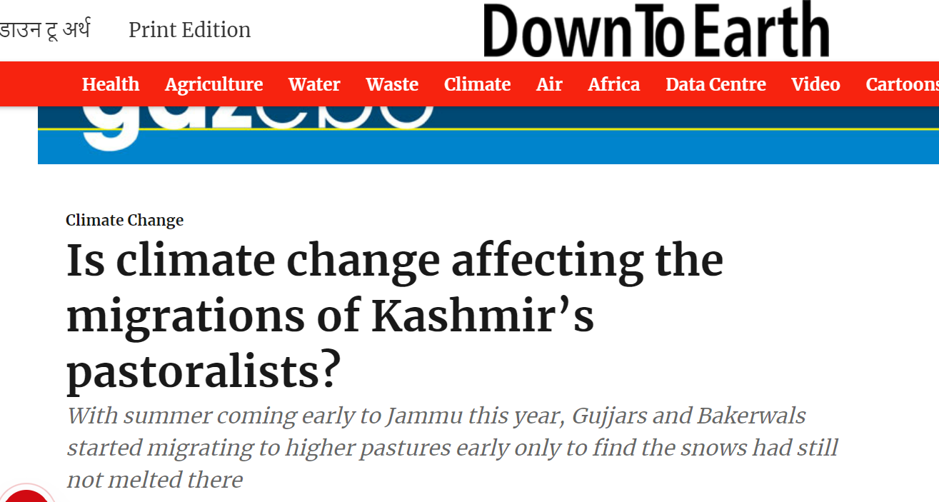
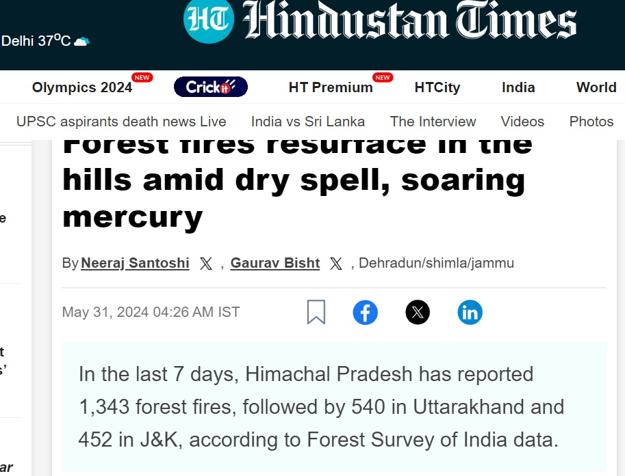
Emerging Threats
Climate Change
GAUGE THE THREAT
SOME NEWS HEADLINES

Slide 16
Emerging Threats
Climate Change
Extreme weather events are threat to already marginalised pastoral community. In absence of suitable technological penetration threat to life and property has increased overtime.
No snowfall situation leads to low water availability and also prevents sufficient resting period for pastures to recoup.
Forest Fires are occurring now year round with no specific season. Forest Fires are not only ravaging the productive forest ecosystem but also making pastoralists an easy scape goats for taking blame of forest fires during migratory season.
Uncertain migration- As extreme events are forcing to stay in transit Behaks in abnormally cold events or early migration due to high temperatures.
Changing Land use Patterns- Increased temperatures may lead to upward migration of tree species reducing areas under alpine pastures.
Developing resilience in the community through modern technology, enhanced knowledge & skill base, & greater role in decision making.
Build resilience by training for Natural Disasters

Slide 17
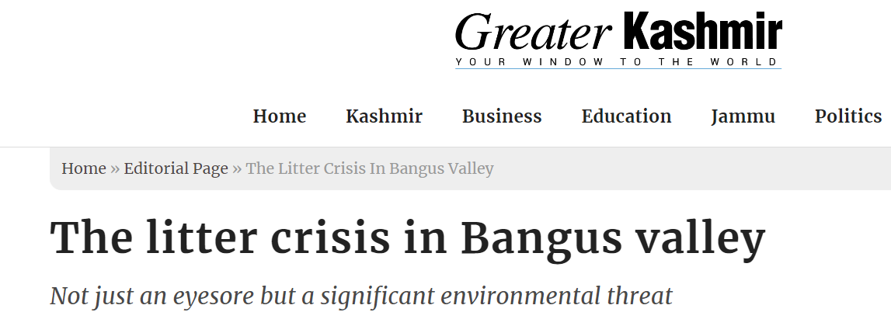
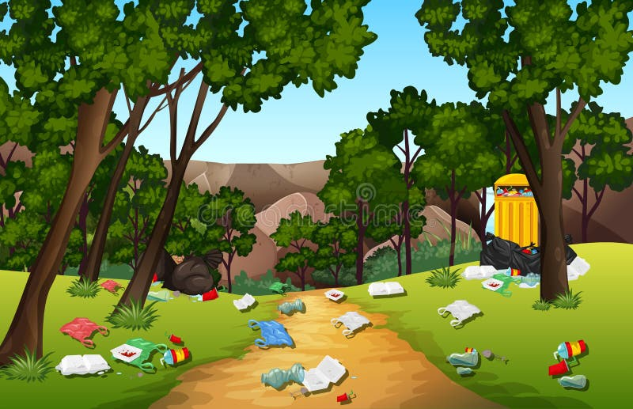
Emerging Threats
Tourism

Slide 18
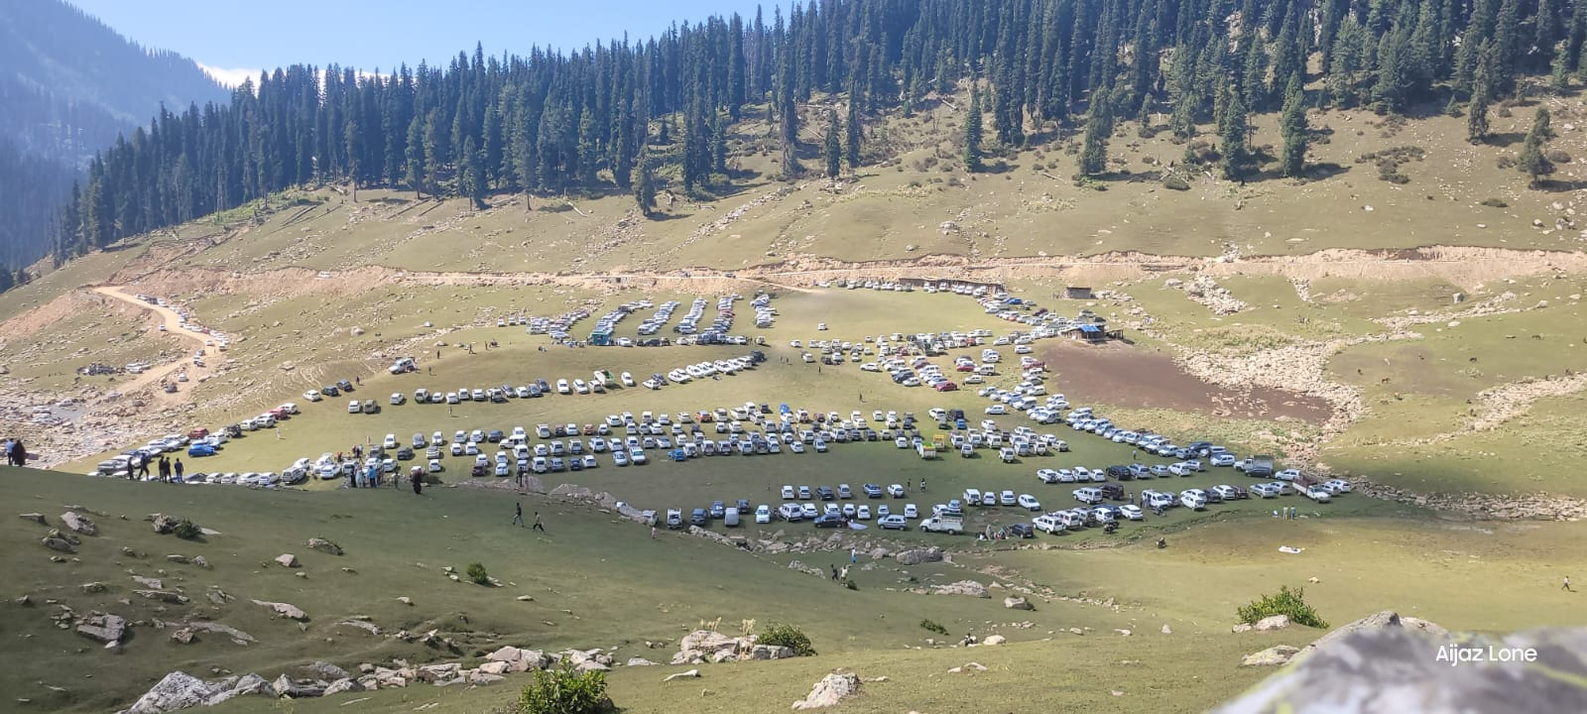
PICTURE SPEAKS LOUDER THAN WORDS
BANGUS PASTURE -2YRS APART
COMMERCIAL TOURISM WILL LEAD TO:
DEGRADATION & PRODUCTIVITY LOSS OF PASTURES.
RESOURCE COMPETITION WITH TOURISM PLAYERS.
(GRAZING & TOURISM SEASON OVERLAP)
ECOTOURISM OR GREENWASHING
NEED FOR FOREST DEPARTMENT FACILITATED COMMUNITY OPERATED COMMUNITY MANAGED LOW IMPACT TOURISM
(BIODIVERSITY MANAGEMENT COMMITTEES)

Slide 19
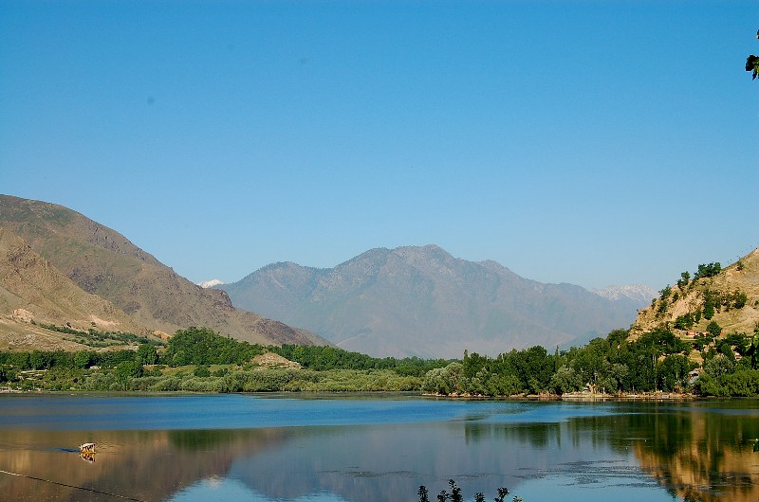
Emerging Threats
Tree Plantations
FOREST DEGRADATION IS VISIBLE-ISN’T IT…..
LET’S PLANT MORE TREES!!!!

Slide 20
Emerging Threats
Tree Plantations
Should we do the Popular thing or Right thing
Tree Plantations are popular and we are seeing love for tree plantations increasing and so the enhanced targets. Now is the right time to define where we want to take this Forest Cover which has become synonymous to tree cover.
Should we go on planting trees on all forest areas devoid of trees.
Whether the ecosystems like scrublands, shrub dominated areas, grasslands occurring naturally are not important ecosystems which harbour diverse and unique flora and fauna.
As per the ISFR 2021 the grassland area of JKUT is around 4437.70 sqkm. Grasslands need detailed study and we have to ensure we are not increasing the tree cover at the expense of grasslands. The dwindling grasslands means reduced herbivores and increased man-animal conflict. Further reduced grasslands means reduced grazing grounds for nomads, cattle herders etc which will bring great amount of conflict, affect livelihood and in turn the economy.
Need for an Landscape Based approach for Conservation

Slide 21
IMPORTANT ENABLING LEGAL INSTRUMENTS
& KEY INITIATIVES

Slide 22
FOREST RIGHTS ACT
DULY RECOGNISED
INDIVIDUAL RIGHTS
COMMUNITY RIGHTS
PROVISION OF FACILITIES FOR TRIBAL VILLAGES
AWARENESS & LEADERSHIP
RIGHT PROCEDURES
FULL POTENTIAL

Slide 23
Forests For Livelihood
Deregulation of NTFPs– Promulgation of Sustainable Collection & Utilization of NTFP Policy 2022
Promotion of Forest Produce based livelihood activities through SHGs.
Handicraft items from Chir Pine Needles.
Briquettes as clean fuel from Chir Pine Needles
Dona-Patals from leaves as substitute of SUP items
Rope making from grasses
Help reduce incidences of Forest Fires and generating livelihood avenues for locals
Endeavor is to scale up these activities and increase the sustainability by marketing support
Training and capacity building is ongoing process

Slide 24
J&K NTFP Policy 2022
For sustainable management and livelihood enhancement
79 Biodiversity Management Committees (BMC)
75 NTFP Depots registered
1831 Families/Individuals directly involved
996.66 qtls NTFPs traded during 2023-24
>19 Species Traded
Rs 4.56 Crores Earned by Local Collectors
24,904/annum Avg additional income earned by a family
15.91 lakhs Levy Generated by BMCs at Panchayat level

Slide 25
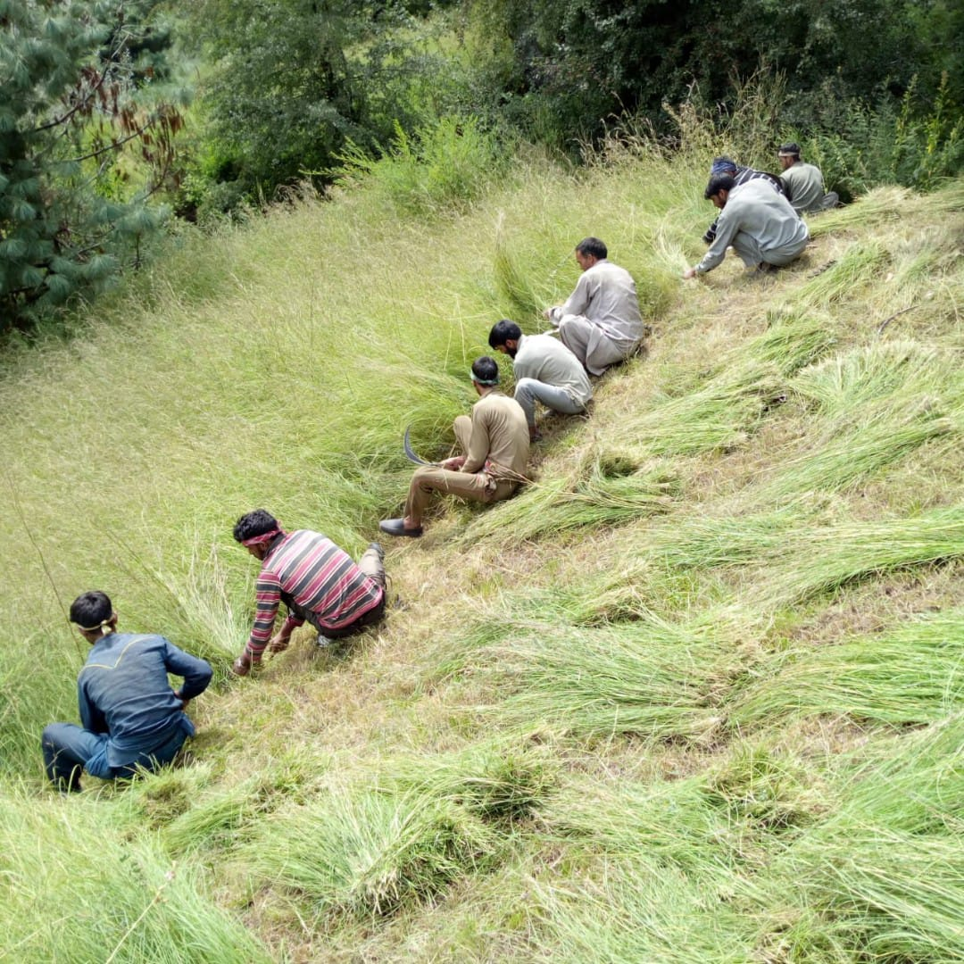
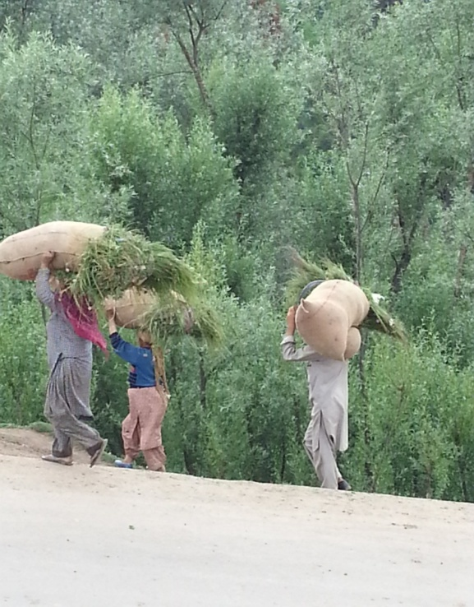
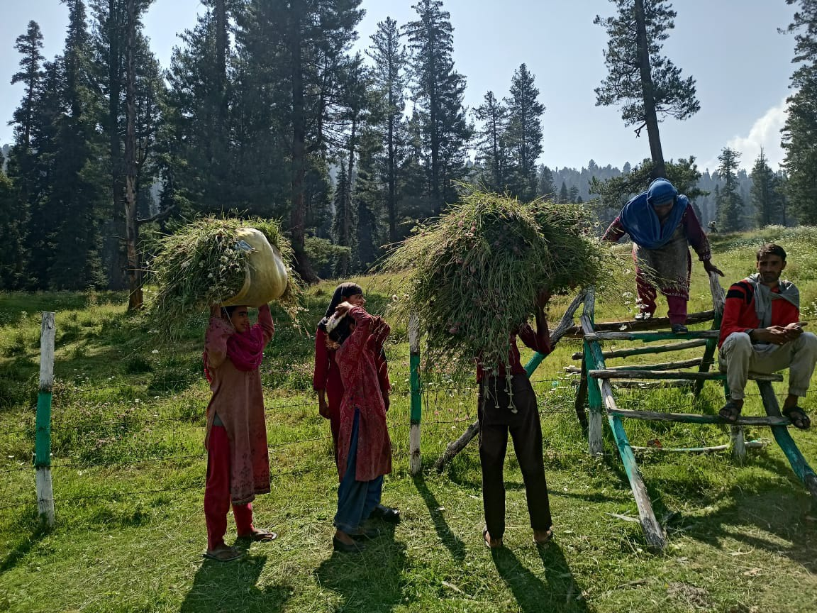
Fodder from Forests
Enhanced focus on Fodder Production.
Linkages with HADP Progrmme.

Slide 26
Important Key Initiatives by J&K Forest Department
Van Se Jal, Jal Se Jeevan
To Promote Soil and Water Conservation and Rain Water Harvesting in Forest and Non Forest Areas
Construction / Revjuvenation of Ponds, traditional Waterbodies, Check dams is being taken up.
Trench planting and percolation trenches in sloppy areas to enhance ground water recharge.
The water harvesting bodies improve ground water level, promote regeneration of Forests and enhance ecosystem productivity.

Slide 27
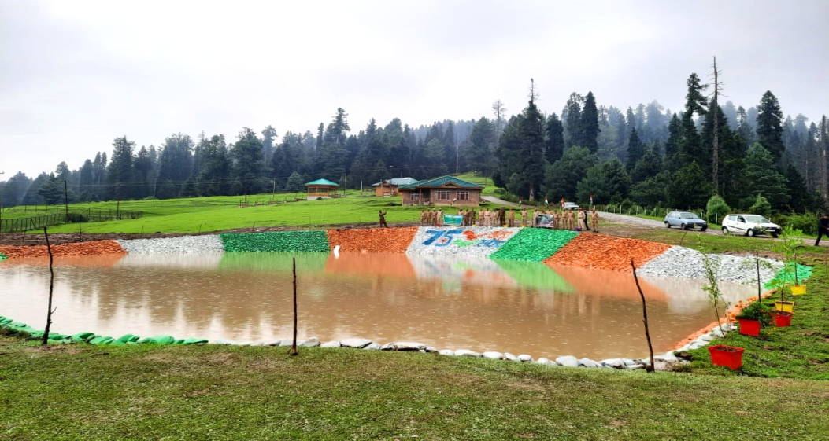
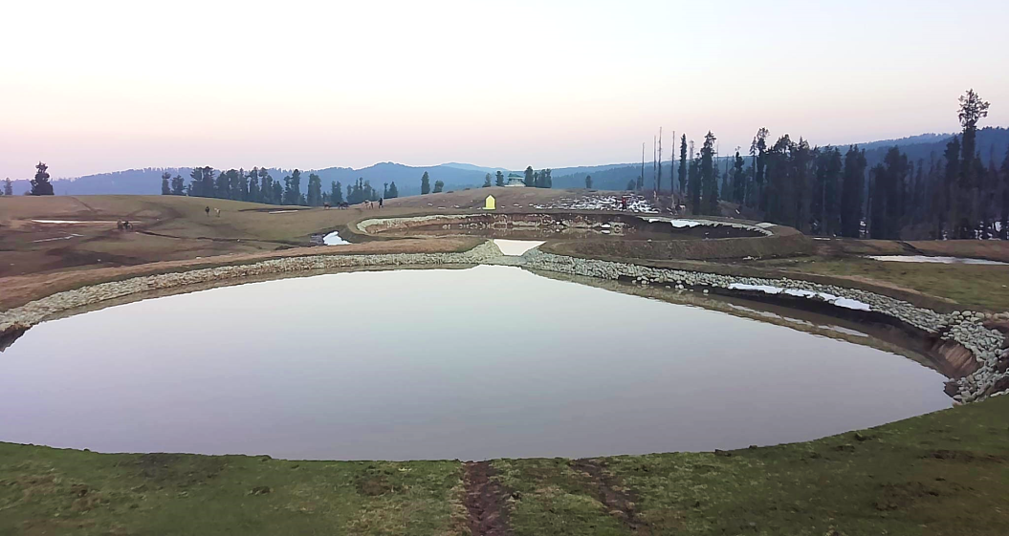
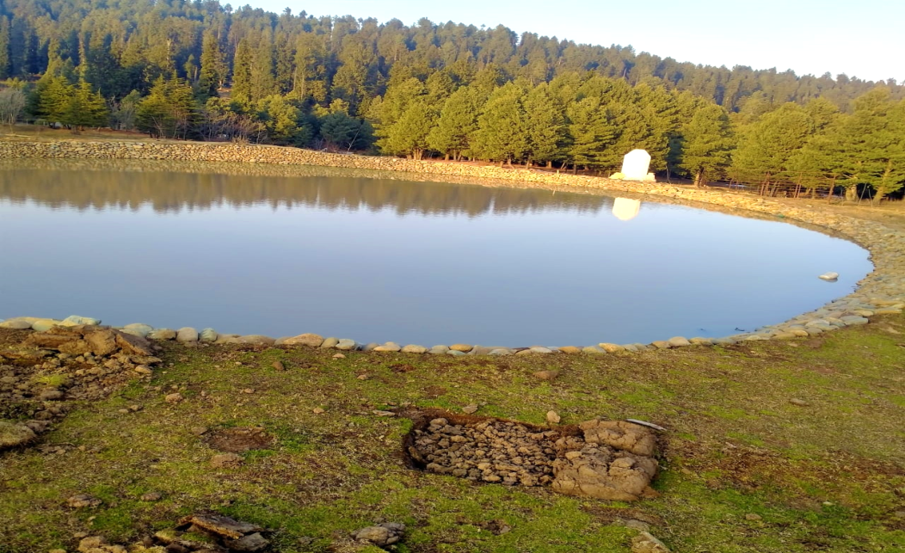
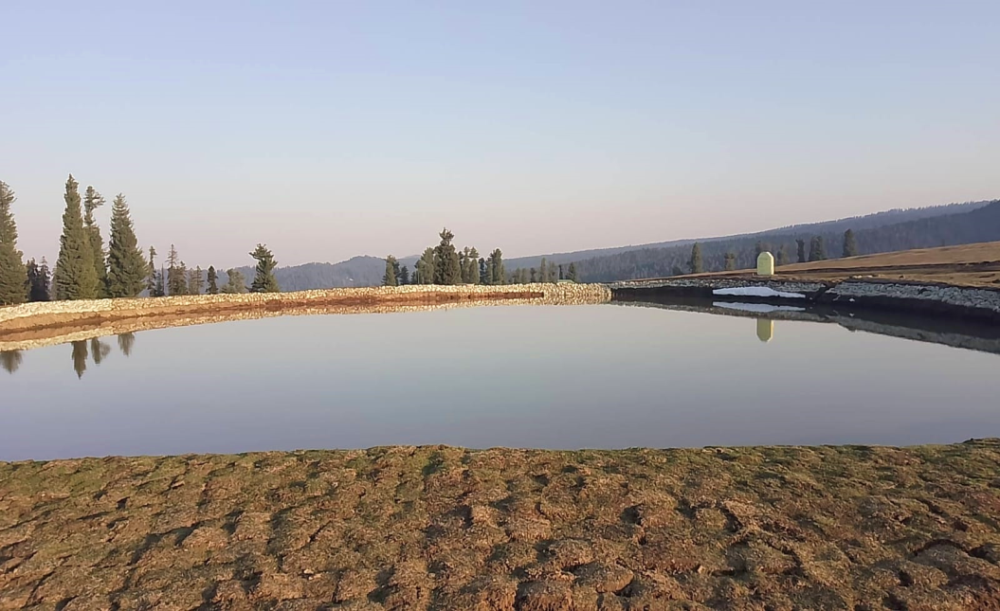
Yousmarg
(Kanidajan Forest Block)
Sochlipathri
(Gurwaith Forest Block)
Khankabal
(Yousmarg Forest Block)
Sochlipathri
(Raiyar Forest Block)

Slide 28
Together We can make a difference
PASTORALISTS
FOREST
RESEARCH
INSTITUTIONS
RURAL
DEVELOPMENT
EDUCATION
ANIMAL
HUSBANDARY
HEALTH

Slide 29
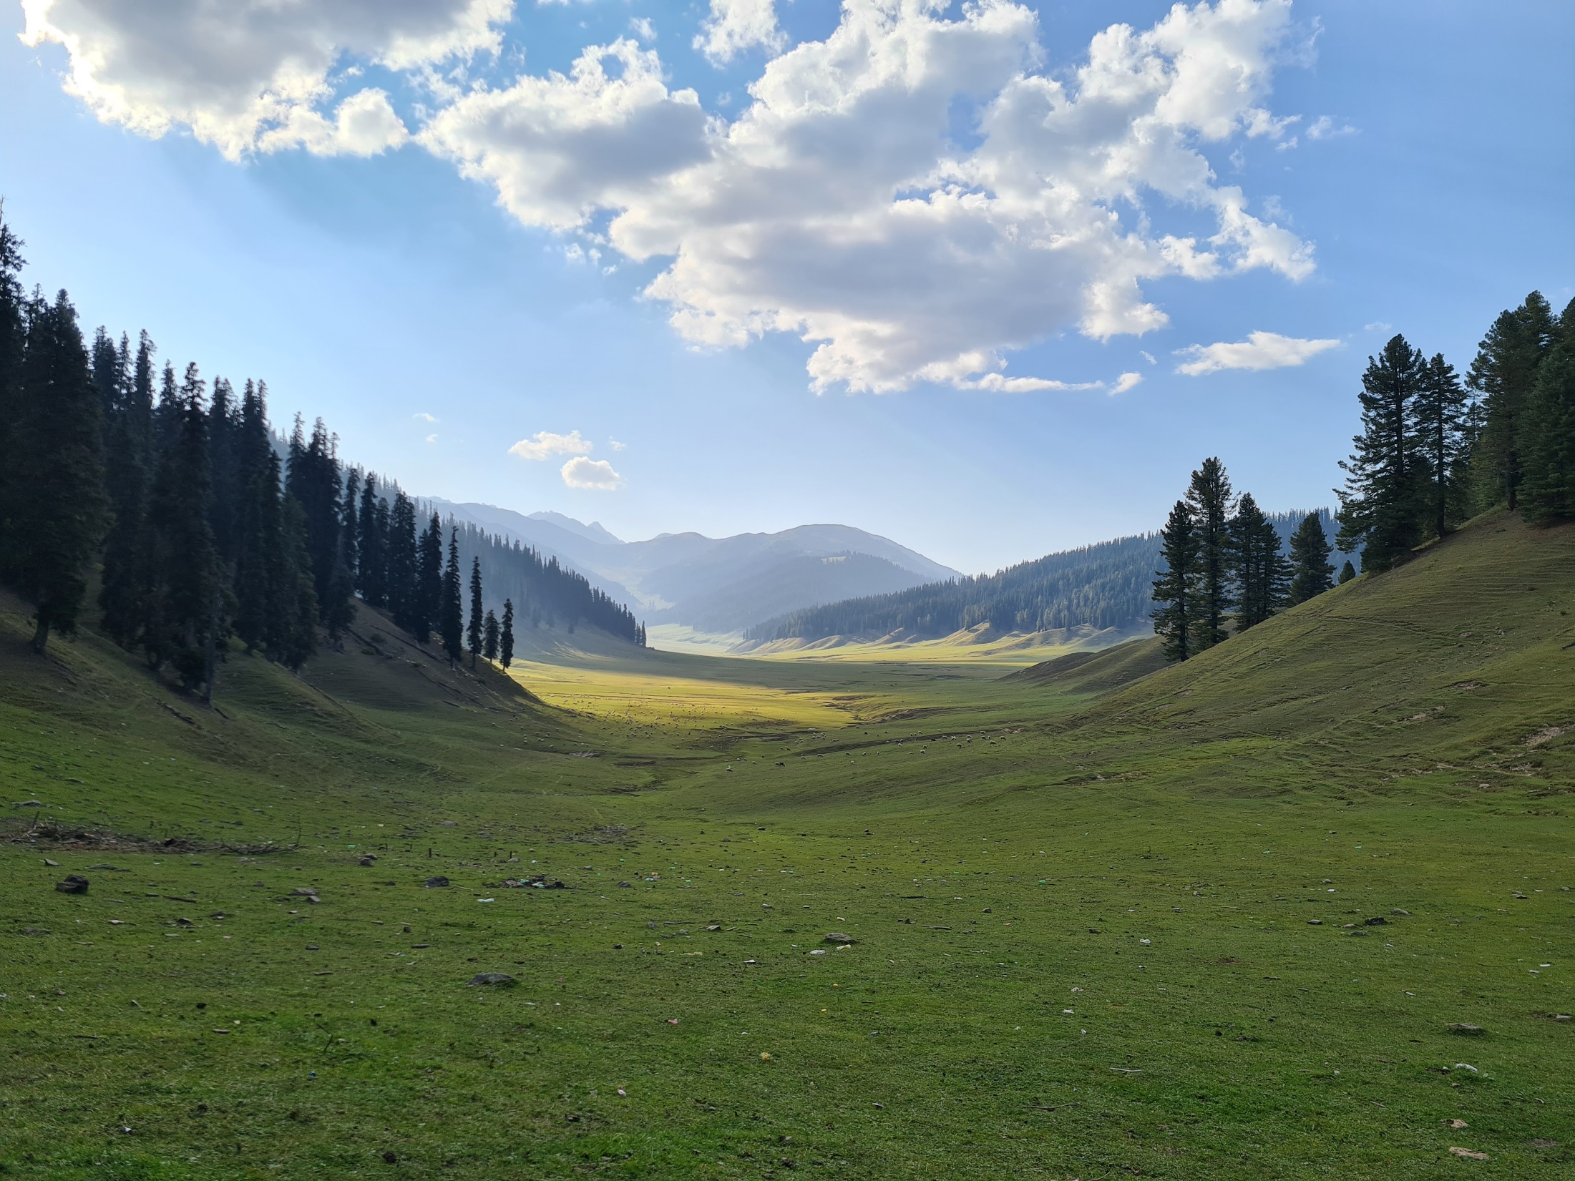
THANKS

